Slide 1
International study centre
Data Structures and the C++ Standard Template Library
Name : John Alamina
Email : john.alamina@hud.ac.uk

Slide 2
Contents
Introduction to Data Structures and Algorithms
The Standard Template Library
C/C++ strings
STL array
STL vector

Slide 3
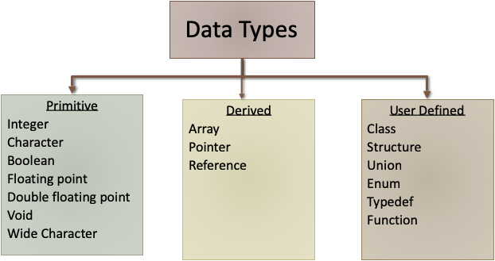
Data Structures and algorithms

Slide 4
Data Structures and algorithms

Slide 5
Standard Template Library
STL has four components
Algorithms
Containers
Functions
Iterators

Slide 6
Standard Template Library
STL has four components
Algorithms
Containers
Functions
Iterators

Slide 7
Standard Template Library
STL has four components
Algorithms
Containers
Functions
Iterators

Slide 8
Abstract Data types
We will study these
Linked List – A set of nodes singly or doubly or circularly connected.
Trees – A directed set of nodes connected in a hierarchical structure
Graphs – Group of nodes connected in any particular manner.
Records – A generic term for Structs and classes without operations.
Stack
Queues
We won’t study these
Heap
Hash-table – Efficient memory for fast lookup.
Map

Slide 9
STL Containers
Pair
Vector
List
Dequeue
Queue
Priority Queue
Stack
Set
Multiset
Map
Multimap
Heap using STL C++

Slide 10
STL Container Groups
Sequence Containers
Array
List
Dequeue
Vector
Ordered Containers
Map
Set
Multimap
Multiset
Unordered Containers
Unordered_map
Unordered set
Unordered_multimap
Unordered multiset
Adaptive Containers
Stack
Queue
Priority queue

Slide 11
STL Containers
Pair
Vector
List
Dequeue
Queue
Priority Queue
Stack
Set
Multiset
Map
Multimap
Heap using STL C++

Slide 12
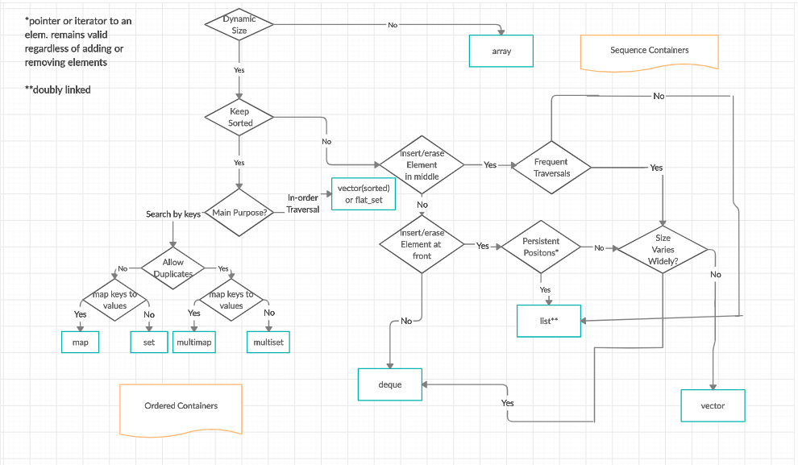
The Standard Template Library
https://www.geeksforgeeks.org/the-c-standard-template-library-stl/

Slide 13
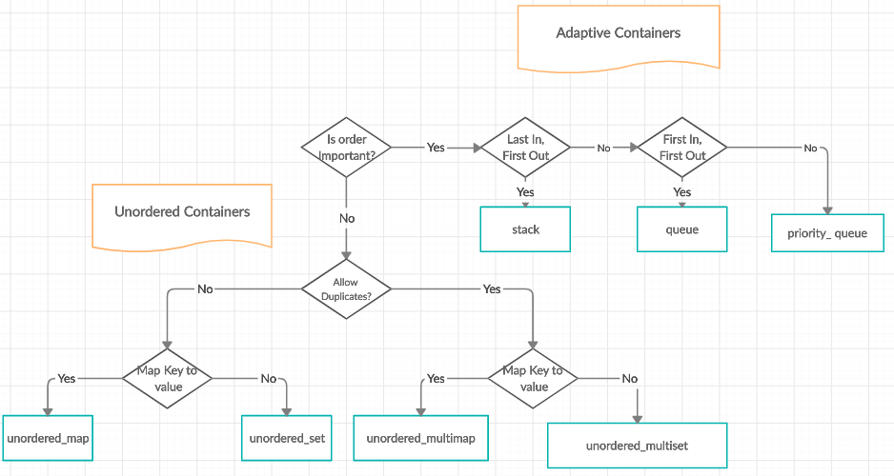
The Standard Template Library
https://www.geeksforgeeks.org/the-c-standard-template-library-stl/

Slide 14
STL Container Groups
Sequence Containers
Array
List
Dequeue
Vector
Ordered Containers
Map
Set
Multimap
Multiset
Unordered Containers
Unordered_map
Unordered set
Unordered_multimap
Unordered multiset
Adaptive Containers
Stack
Queue
Priority queue

Slide 15
C-Style strings
Declare string e.g char string[50];
String literal e.g. "This is a static string"
String initialisation e.g. char str[50]="This is a static string";
Dynamic memory declaration char* arr=new char[50];
Dynamic memory cleanup delete [] arr;

Slide 16
C-Style string functions
int strcmp ( const char *s1, const char *s2 );//compares strings
char *strcat ( char *dest, const char *src ); //string concatenation
char *strcpy ( char *dest, const char *src );//string copy
size_t strlen ( const char *s );//string length
char *strncpy ( char *dest, const char *src, size_t len );//safe copy

Slide 17
C++ Style strings
Include string.h
Declare string e.g std::string str ;
String initialisation e.g. std::string str="This is a static string";
Dynamic memory declaration std::string* str=new string;
Dynamic memory cleanup delete str;

Slide 18
C++ Style string functions
int compare( const basic_string& str ) const;//compares strings
char *strcat ( char *dest, const char *src ); //string concatenation
size_type copy( CharT* dest, size_type count, size_type pos = 0 ) const;//string copy
size_type length() const;;//string length
substr( size_type pos = 0, size_type count = npos ) const;//substring
getline(std::cin, name); //get line from console keyboard input
size_type find( const basic_string& str, size_type pos = 0 ) const;//find position of substring
https://en.cppreference.com/w/cpp/string/basic_string
https://en.cppreference.com/w/cpp/string/basic_string/substr
https://en.cppreference.com/w/cpp/string/basic_string/copy
https://en.cppreference.com/w/cpp/string/basic_string/getline
https://en.cppreference.com/w/cpp/string/basic_string/operator%2B

Slide 19
STL Array
Declaration
#include <array>
std::array<int, 3> myArray; // declare an integer array with length 3
Initialisation
std::array<int, 5> myArray = { 9, 7, 5, 3, 1 }; // initializer list
std::array<int, 5> myArray2 { 9, 7, 5, 3, 1 }; // uniform initialization
std::array<int, > myArray { 9, 7, 5, 3, 1 }; // illegal, array length must be provided
std::array<int> myArray { 9, 7, 5, 3, 1 }; // illegal, array length must be provided
std::array myArray { 9, 7, 5, 3, 1 };
myArray.at(1) = 6; // array element 1 valid, sets array element 1 to value 6
myArray.at(9) = 10; // array element 9 is invalid, will throw an error

Slide 20
STL Array
Size and sorting
std::array myArray { 9.0, 7.2, 5.4, 3.6, 1.8 };
std::cout << "length: " << myArray.size() << '\n';
#include <algorithm> // for std::sort
#include <array>
#include <iostream>
int main()
{
std::array myArray { 7, 3, 1, 9, 5 };
std::sort(myArray.begin(), myArray.end()); // sort the array forwards
// std::sort(myArray.rbegin(), myArray.rend()); // sort the array backwards
for (int element : myArray)
std::cout << element << ' ';
std::cout << '\n';
return 0;
}

Slide 21
Array ADT
Properties
List of elements
Array size
Methods
Sort( )
writeAt(index,value) // i.e. arr[index]=value
readAt(index) // i.e. arr[index]
exists(value)
indexOf(value)

Slide 22
Vector =
Dynamically sized array
Declaration
#include <vector>
// no need to specify length at initialization
std::vector<int> array;
std::vector<int> array2 = { 9, 7, 5, 3, 1 }; // use initializer list to initialize array
std::vector<int> array3 { 9, 7, 5, 3, 1 }; // use uniform initialization to initialize array (C++11 onward)
Access
array[6] = 2; // no bounds checking
array.at(7) = 3; // does bounds checking
Vectors remember their size - v.size()
Vectors can be resized - v.resize()
Vectors can be appended - v.push_back(elem)
https://www.geeksforgeeks.org/vector-in-cpp-stl/

Slide 23
Exercise
On the discussion space, come up with the abstract data type definition for the vector class that includes its properties and methods. Also comment on your classmate's definition.

Slide 24
Any Questions?

